Slide 1
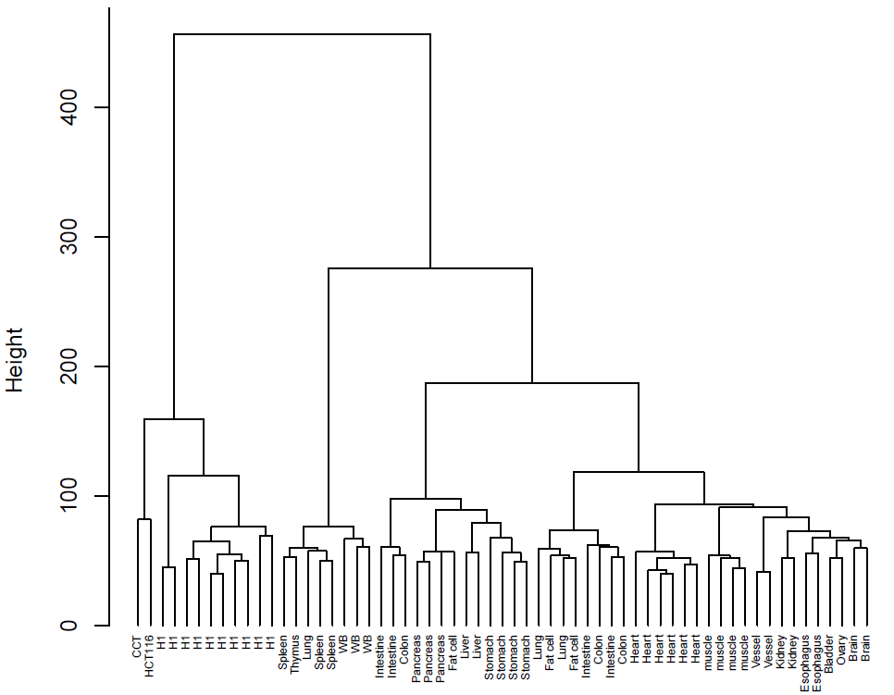
Unsupervised Cluster Analysis to 61 samples based on Genome-wide MHL value
54209 MHL Regions
2 CCT, 3 WBC, 10 H1, 10 N37, 36 Salk
Aggregation of the samples from same study were disappeared
Same kinds of tissue cluster together

